Slide 1
Operating Systems (Introduction)
Presented By Sudeshna Kundu (Mondal)

Slide 2
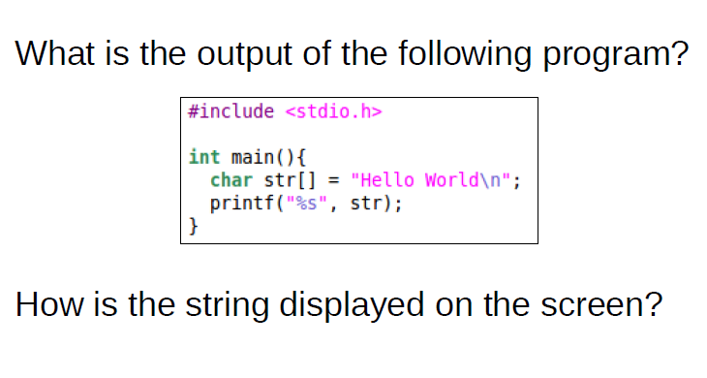
A simple program

Slide 3
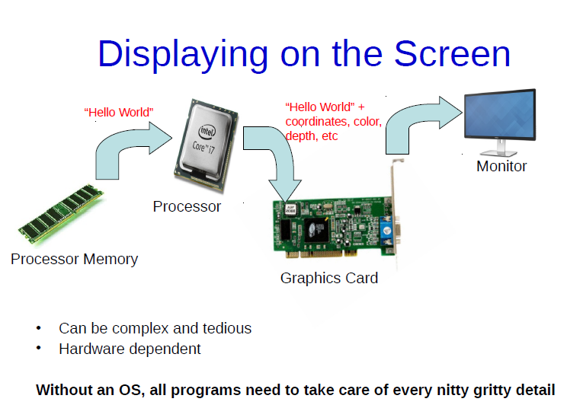
Hardware Abstraction

Slide 4
Explaining the story
The string “Hello World” would be present in some memory location in the Main Memory which is also called as the RAM
Certain Instructions in the Processor would read the string byte by byte from the Main Memory and then copy them on to something known as a Video Buffer.
Along with copying the string “Hello World” to the Video Buffer, other attributes are added. For instance, things like the colour of the string to be displayed, the x y coordinates on the monitor where the “Hello World” string needs to be displayed and other monitor specific attributes such as the depth and so on.
String which is copied to the Video Buffer is then read by the Graphics Card which would then display it on the Monitor

Slide 5
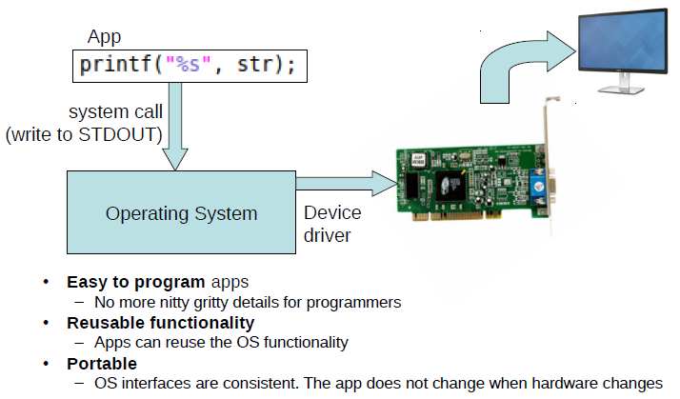
Hardware Abstraction
The functions which change the execution mode of the program from user mode to kernel mode are known as system calls
In computing, a system call is the programmatic way in which a computer program requests a service from the kernel of the operating system it is executed on

Slide 6
Hardware Abstraction
Operating Systems essentially provide abstraction. It sits in between the applications that we write and the hardware, and abstract all the nitty-gritty details of the Hardware from the applications
Simple statement such as this printf(“%s”, str) would eventually reside in something known as a system call which would trigger the Operating System to execute.

Slide 7
Advantages of hardware abstraction?
Easy to Program: Programmer need not know the nitty-gritty details about the Hardware any more
Reusable functionality: There is the single module in the Operating System which handles all printf's from all applications executing on the System
Portability: when we write a program which uses something like a printf statement, we do not really bother about what Hardware it runs on. It could run in a Desktop for instance or a Server or a Laptop or if complied appropriately, also in several embedded devices. So, essentially Applications will not change even though the underlying Hardware changes

Slide 8
What is an Operating System?
A program that acts as an intermediary between a user of a computer and the computer hardware
Operating system goals:
Execute user programs and make solving user problems easier
Make the computer system convenient to use
Use the computer hardware in an efficient manner

Slide 9
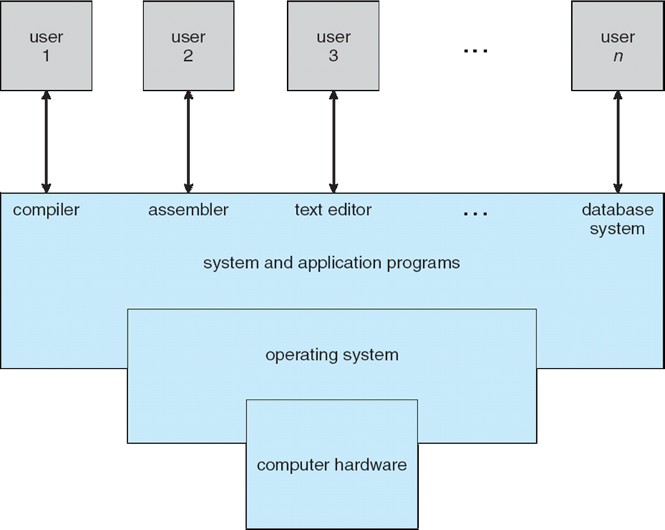
Computer System Structure
Computer system can be divided into four components:
Hardware – provides basic computing resources
CPU, memory, I/O devices
Operating system
Controls and coordinates use of hardware among various applications and users
Application programs – define the ways in which the system resources are used to solve the computing problems of the users
Word processors, compilers, web browsers, database systems, video games
Users
People, machines, other computers

Slide 10
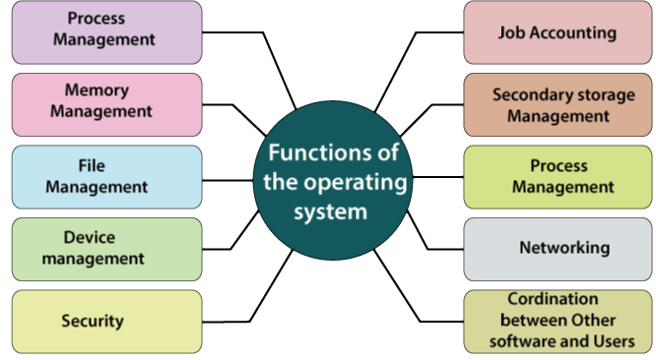
Operating system functions
The functions of Operating System are:
Process Management
Memory Management
File Management
Device Management
Secondary storage Management
Security
Coordination between other software and users
Networking
Job Accounting
Error detecting aids

Slide 11
Operating system functions
1.Process Management: – Process Management support operating system to create and delete processes. Process management also offers a mechanism for synchronization and communication among processes.
An operating system performs the following activities for process management:
The operating system maintains the track of the processor and the status of a process. The software which performs this task is referred to as a traffic controller.
It assigns the processor to the process.
It also performs the task of the de-allocated processor, if a process is no longer needed for the processor.
2. Memory Management: – Memory Management is used to manage Primary memory. The memory management module performs the allocation job and de-allocation of memory to the program.
The operating system performs various activities for memory management are:
It keeps track of memory means which part of the memory is in use, and what part of the memory is not in use.
Operating system helps to allocate the memory at the time when the process request for memory.
If process no longer needs memory, then de-allocates the memory.
In multiprogramming, the task of memory allocation to the processes is done with the help of Operating System.

Slide 12
Operating system functions
3. File Management: – For fast or simple navigation and easy usage file system is organized into directories. These directories consist of directories and other files. It helps to handle all the file-related tasks like organization storage, retrieval, sharing, naming and files protection. It preserves track of information, location, status, user, etc.
4. Device Management: – Operating System performs the task of allocations and de-allocations of the devices. It helps to keeps the track of all the devices. With the help of Operating system, device communication via their respective drivers is performed. It manages the device in an effective manner.
5. Secondary Storage Management: – Operating System is responsible for secondary storage management. The System has various levels of storage that consist of primary storage, secondary storage, and cache storage. The set of instruction and data are stored in primary memory or cache memory so that the program which is running can reference it.
6. Security: – The Operating system is responsible for security means the operating system prevents the data and information from unauthorized access and threats.
7. Coordination between other software and user: – The operating system also performs the task of coordination between other software and users. OS directs as well as allocates assemblers, interpreters, compilers, and other software to different computer system users.

Slide 13
Operating system functions
8. Networking: – A distributed system means a bunch of processors which do not share memory hardware devices and clock. With the help of the network, the processor communicates with each other.
9. Job accounting: – Operating system performs the function of job accounting by keeping the track of time and resource used by several jobs and users.
10. Error detecting aids: – The operating system also performs the task of error detection. It continuously monitors the system to find or detect errors and prevents the system from the error.

Slide 14
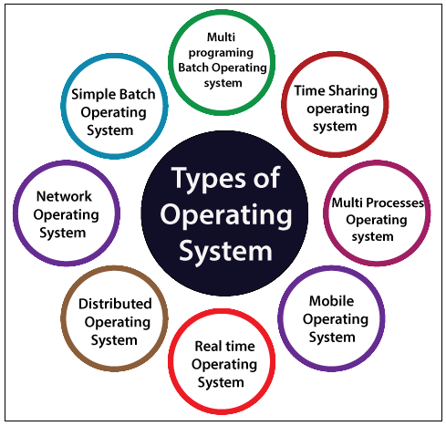
Types of Operating System
There are various types of operating system:
Simple Batch Operating System
Multiprogramming batch Operating System
Time-sharing Operating System
Multiprocessor Operating System
Distributed Operating System
Network Operating System
Real-time Operating System
Mobile Operating System

Slide 15
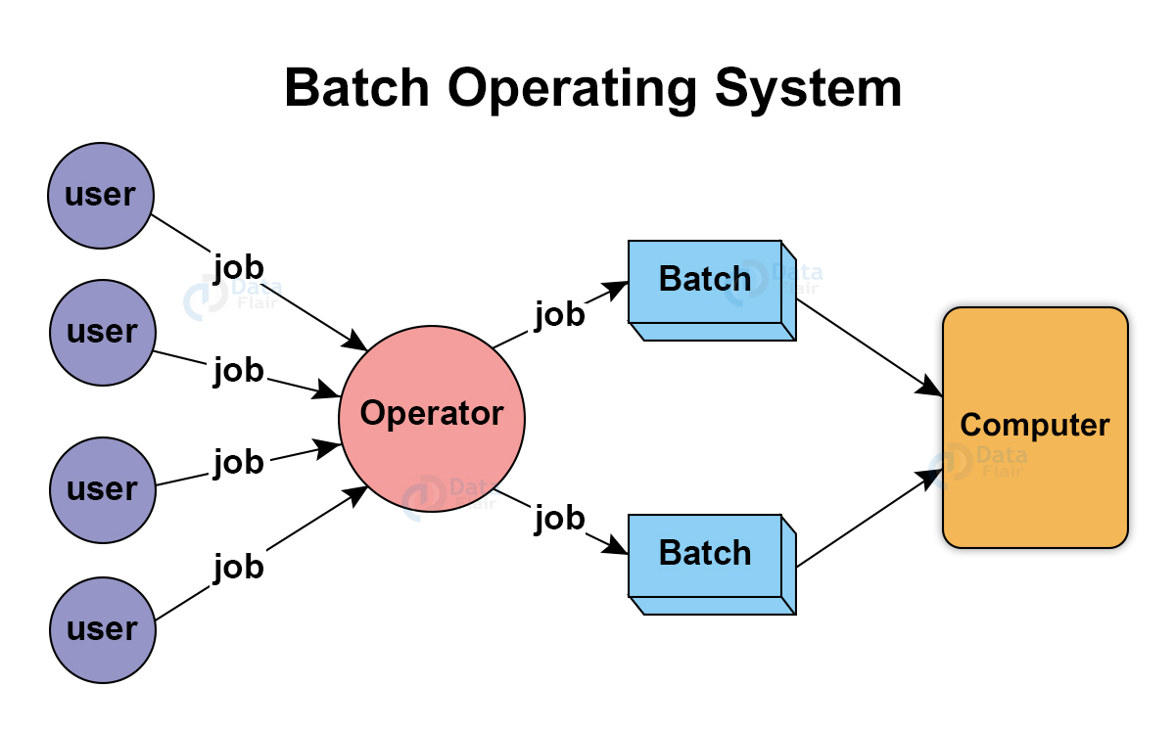
Simple Batch operating system
In the simple batch operating system, there is no direct communication between the user and the computer. In this, firstly, the user submits a job to the computer operator, and after submitting the job, the computer operator creates a batch of the jobs on an input device. The batch of jobs is created on the basis of the type of language and needs. After the batch of the job is created, then a special program monitors and manages each program in a batch. Example: Bank Statements, Payroll system, etc.
Advantages of Simple Batch Operating System
There is no mechanism to prioritize the processes.
There is no communication between the user and the computer.
Disadvantages of a Simple Batch Operating System
It is hard to debug.
The Batch operating systems are costly.

Slide 16
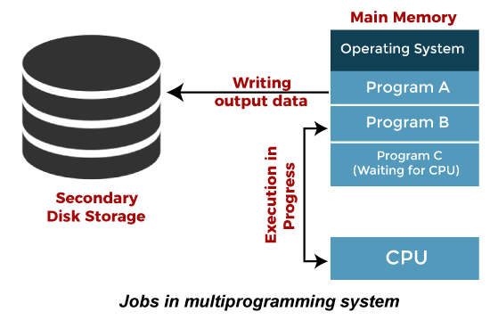
Multiprogramming Batch Operating System
In Multiprogramming Batch Operating System, the Operating system first selects the job, and after selecting the job, it begins to execute one of the jobs from memory. When this job requires an I/O operation operating system, it switches to another job (operating system and CPU always busy). In this, the jobs present in memory are always minimum than the jobs present in the job pool.
If different jobs are ready to execute at the same time, then the job is selected for CPU scheduling. In a simple batch operating system, sometimes CPU is idle and doesn’t perform any task, but in the multiprogramming batch operating system, CPU is busy and will never sit idle and always keeps on processing.

Slide 17
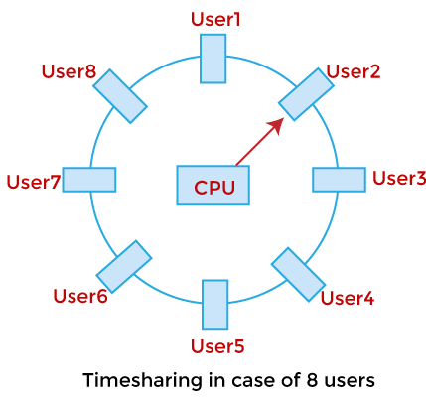
Multitasking or Time-Sharing Operating System
The Time-sharing systems are also called Multitasking systems. In Time-sharing operating system, we assign some time to each job so that all the jobs work efficiently and smoothly. The time taken by each job to execute the job is known as quantum. After the interval of time is over, the operating system moves to the next task. Time-sharing is sharing the processor’s time with multiple users simultaneously.
The major difference between Time-sharing operating system and Multiprogramming batch operating system is that the time-sharing operating system aims to minimize the response time, whereas the Multiprogramming batch operating system is to increase the use of the processor.

Slide 18
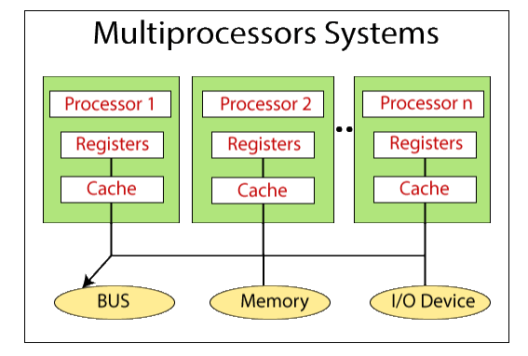
Multiprocessor Operating System
A Multiprocessor Operating System means the use of two or more processors within a single computer system. These multiple processors are in close communication and share the memory, computer bus, and other peripheral devices. These systems are known as tightly coupled systems. It offers high speed and computing power. In Multiprocessor operating system, all the processors work by using a single operating system.
Advantages of Multiprocessor
Improved performance.
By maximizing the number of processors, more work is done in less time. In this way, throughput is increased.
Increased reliability.

Slide 19
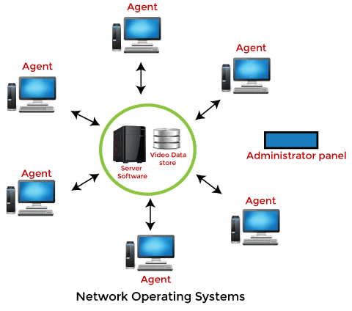
Network Operating System
This OS runs on a server allowing it to manage data, users, groups, security, applications, and other networking functions. It allows shared access of files, printers, security, applications, and other networking functions over a small private network or a LAN. Users are well aware of its underlying configuration, making it a tightly coupled system.
Advantages of Network Operating System:
It has stable and centralized servers that can handle security concerns well.
Integration of new technologies and hardware up-gradation is easier.
Remote server access is possible.
Disadvantages of Network Operating System:
High cost of servers.
Most operations could only be performed through a central location.
It requires regular maintenance and updating.

Slide 20
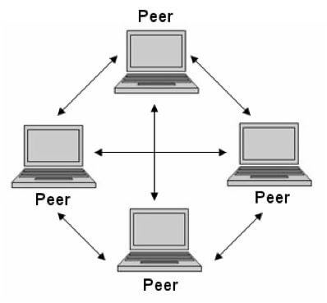
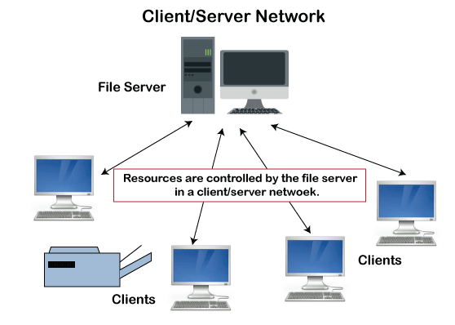
Network Operating System
Types of network operating system
Peer-to-peer network operating system: The type of network operating system allows users to share files, resources between two or more computer machines using a LAN.
Client-Server network operating system: It is the type of network operating system that allows the users to access resources, functions, and applications through a common server or center hub of the resources. The client workstation can access all resources that exist in the central hub of the network. Multiple clients can access and share different types of the resource over the network from different locations.

Slide 21
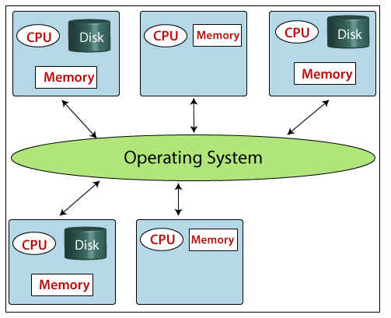
Distributed Operating System
The Distributed Operating system is not installed on a single machine, it is divided into parts, and these parts are loaded on different machines. A part of the distributed Operating system is installed on each machine to make their communication possible. Distributed Operating systems are much more complex, large, and sophisticated than Network operating systems because they also have to take care of varying networking protocols.
Goals:
Connecting Resources / Users
Transparency
Scalability
Reliability
Performance

Slide 22
Real-Time Operating System
Real-time operating systems are the operating systems that are used in real-time applications where the data processing must be done in a fixed interval of time. The Real-time operating system gives the response very fast and quick.
Hard-Real time: – In Hard-Real time system, there is some deadline for executing the task, which means that the task must start its execution on the particular scheduled time, and should complete within the assigned duration of time.
Example: – Aircraft systems, Medical critical care System, etc.
Soft-Real time: – In the Soft-Real time system also, we assign a time to each process, but some delaying in time is acceptable. So, in Soft-real time, deadlines are handled softly. That’s why it is called Soft-Real time. Example: – Live stock price and Online Transaction System.

Slide 23
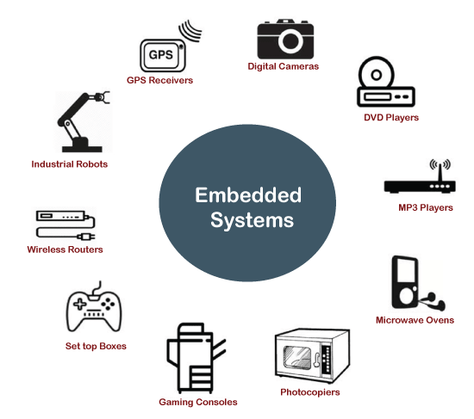
Embedded Operating System
The Embedded operating system is the specific purpose operating system used in the computer system's embedded hardware configuration. These operating systems are designed to work on dedicated devices like automated teller machines (ATMs), airplane systems, digital home assistants, and the internet of things (IoT) devices.

Slide 24
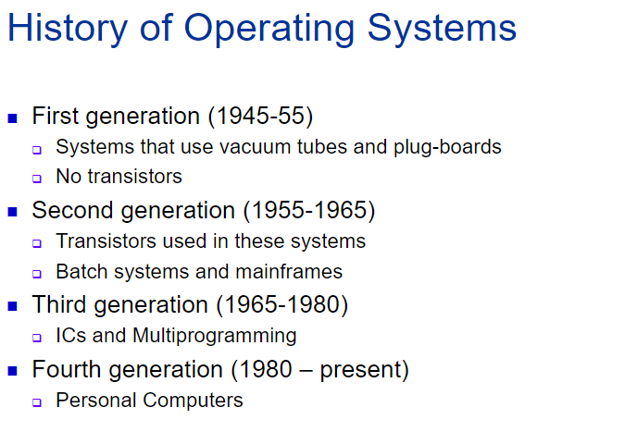

Slide 25
THANK YOU

